Slide 1
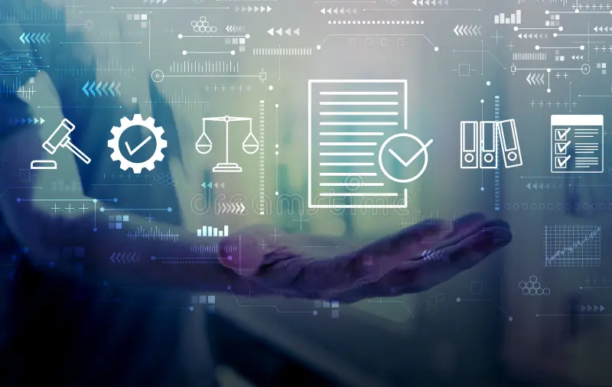

Validate first Build later
Deck presentation
Aug 2026

